Slide 1
Agenda of Training
What is Software Testing?
Why Software Testing?
How much Testing?
Testing Team
Types of Testing
SDLC (Software Development Life Cycle)
STLC (Software Testing Life Cycle)

Slide 2
Agenda of Training
Test Cases and Test Suites
Black-box Testing and its Types
White-box Testing and its Types
Test Design Techniques

Slide 3
Software Testing
What is Software Testing?
It is the process to identify the correctness, completeness and quality of developed computer software.

Slide 4
Why Software Testing?
What is an Error, Bug, Fault and Failure?
    Error: a human action that produces an incorrect result.
    Bug: The presence of error at the time of execution of the software.
    Fault: The state of software caused by an error.
    Failure: Deviation of a software from its expected delivery or service.

Slide 5
Reliability versus faults.
The probability that software will not cause the failure of the system for a specified time under specific conditions.
    Can a system be fault-free?
    Can a software system be reliable but still have faults?
    Is a "fault-free" software application always reliable?

Slide 6
Why do faults occur in software?
Software is written by human beings.
    Who know something but not everything.
    Who have skill, but aren't perfect.
    Who do make mistakes (errors).

Slide 7
Why do faults occur in software?
Under increasing pressure to deliver to strict deadlines.
    No time to check but assumptions may be wrong.
    Systems may be incomplete.

Slide 8
What do software fault cost?
Huge sums and life
      Ariane 5 ($7billion)
      Mariner space probe to Venus ($250m)
      Therac-25 medical radiation therapy device.

Slide 9
What do software fault cost?
Very little or nothing at all.
      Minor inconvenience.
      No visible or physical detrimental impact.
Software is not linear.
      Small input may have very large effect.

Slide 10
So, why is testing necessary?
Because software is likely to have faults - Yes.
To learn about reliability of the software - Yes
To fill the time between delivery of the software and the release date -No.
To prove that software has no faults -No.

Slide 11
So, why is testing necessary?
Because testing is included in the project plan -No
Because failure can be very expensive -Yes.
To avoid being sued by customers -Yes
To stay in business -Yes

Slide 12
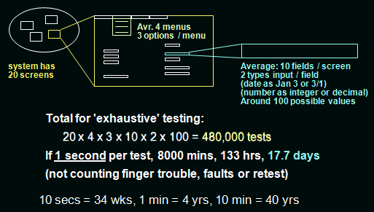
Why not just test everything?

Slide 13
What is exhaustive testing?
When all testers are exhausted -No.
When all the plan tests have been executed- No.
Exercising all combinations of inputs and preconditions -Yes

Slide 14
How much Testing?
It depends on Risk:
  Risk of missing important faults.
  Risk of incurring failure costs.
  Risk of releasing untested of under-tested software.
  Risk of losing credibility and market share.
  Risk of over-testing, ineffective testing

Slide 15
Testing Team
QA Manager.
QA Lead.
Sr. Software Testing Engineer.
Software Testing Engineer.

Slide 16
QA Manager
Coach and mentor other team members to help improve QA effectiveness.
Work with other department representatives to collaborate on join projects and initiatives.
Implement industry best practices related to testing automation and to streamline the QA department.
To make sure QA Process are correctly followed.

Slide 17
QA Lead
Responsible for planning and developing manual test plans and regression test plans.
Identifying the Target test items to be evaluated by the test effort.
Defining the appropriate tests required and any associated test data.
Evaluating the outcome of each test cycle.

Slide 18
Sr. Testing Engineer/Testing Engineer
Writing and executing test cases and reporting defects.
Test engineers are also responsible for determining the best way a test can be performed in order to achieve 100% test coverage of all components

Slide 19
Types of Testing
Black box Testing
  Functional
  Non-Functional testing.
White box testing
  Control Flow Testing.
  Data Flow Testing
  Coverage Testing

Slide 20
SDLC (Software Development Cycle)
Waterfall model
V-Model.
Incremental model
Iterative model
Spiral model
Agile model.

Slide 21
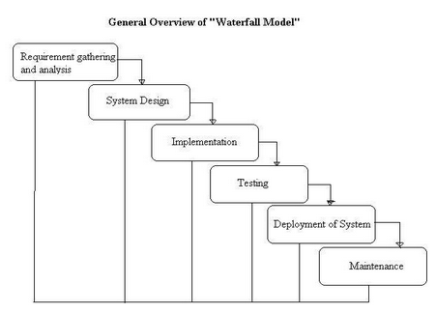
Waterfall model

Slide 22
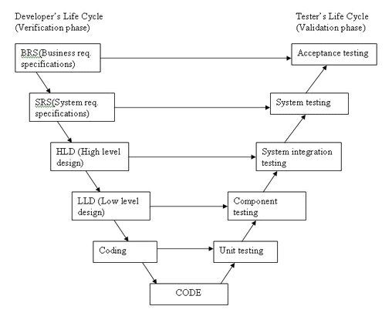
V-model

Slide 23
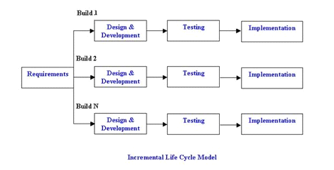
Incremental model

Slide 24
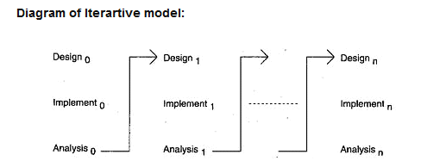
Iterative model

Slide 25
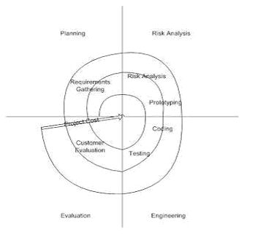
Spiral model

Slide 26
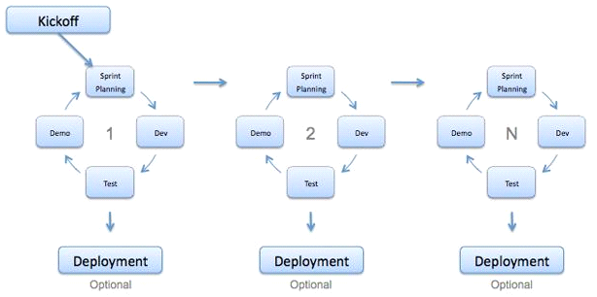
Agile model

Slide 27
STLC (Software Testing Life Cycle)
Requirement Elicitation.
Test Planning
Test Case Development
Test Environment Setup
Test Case Execution
Test Cycle Closure.

Slide 28
Requirement Elicitation.
Understand the objectives.
Feasibility study.
Preparation of Requirement Traceability Matrix (RTM).
Prepared High Level Test Scenarios.
Review the business objectives.
Reviewing High level Test Scenarios.

Slide 29
Test Planning
Making the testplan document.
Selection of Testing tools.
Estimation of Testing Effort.
Determining and Planning the responsibilities and roles for resources.
Requirement of Training.

Slide 30
Test Case Development
Automation scripts and Test Cases creation.
Review the scripts and test cases.
Test data creation and review.
Revisit RTM.

Slide 31
Test Environment Setup
Testing team will understand the environment required for testing and create the list for necessary hardware and software resources.
Test data and test environment will be setup.
When build is ready then smoke testing is performed.

Slide 32
Test Case Execution
Execution of Test Cases according to test plan.
Documentation of test case execution result and log the defects if there are failed test cases.
Defect need to map with test cases in RTM.
Retesting the fixed bugs.
Track the defects to closure.

Slide 33
Test Cycle Closure
Evaluation of consume time, cost, test case coverage, software quality and critical business objectives.
Based on above mentioned parameters need to prepare test metrics.
Quantitative and Qualitative reporting of quality for the work application to the Client.
Analysis the Test result to get the distribution of bugs by severity and type.

Slide 34
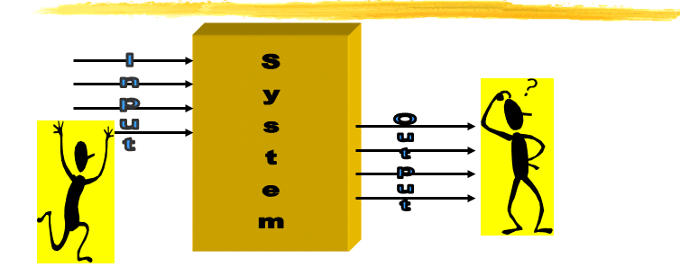
How do you test a System?

Slide 35
Test Cases and Test Suites.
A Test case is a triplet [I,S,O]
  I, is the input to the system.
  S, is the state of the system at which the data is input.
  O is the expected output from the system.
The set of all test cases is called Test-Suite.

Slide 36
Design of Test Cases
Design an optimal Test Suite
  of reasonable size.
  to uncover as many errors as possible.
Systematic approaches are required to design an optimal test suite.
  each test case in the suite should detect different errors.

Slide 37
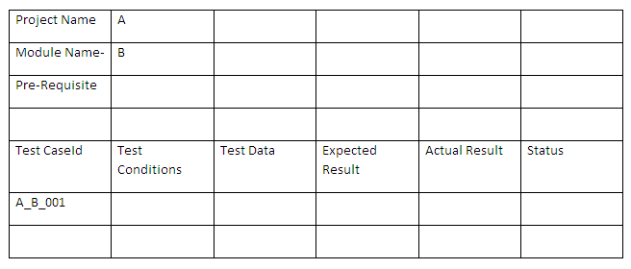
Test Case Template

Slide 38
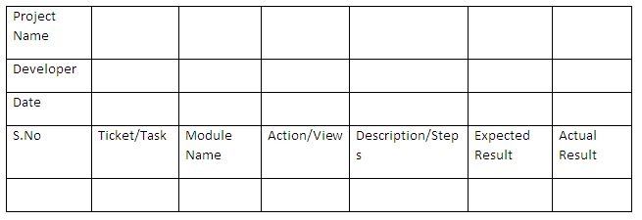
Unit Test Case Format

Slide 39
Black-box Testing
Test Cases are designed using only functional specification of the software: without any knowledge of the internal structure of the software.
For this reason, black-box testing is also known as functional testing.

Slide 40
Black-box testing types
Functional Testing
  It’s a type of testing which tests the functional behavior of the system.
  It tests what system does?
  Testing functionality can be done from two perspectives : requirement based or business-process based.

Slide 41
Black-box testing types
Non-Functional Testing
  It tests the quality characteristics or non-functional attributes of the system.
  It tests how well or how fast something is done.
  Some of the quality characteristics are reliability, usability, efficiency, maintainability, portability etc.

Slide 42
Types of Functional Testing
Unit Testing
Integration Testing
  Big Bang Integration Testing
  Incremental Testing
      Top Down Testing
      Bottom Up Testing
System Testing
Smoke Testing

Slide 43
Types of Functional Testing
Sanity Testing
Confirmation Testing/Retesting
Regression Testing
Compatibility Testing
User Acceptance Testing
    Alpha Testing
    Beta Testing

Slide 44
Non-Functional Testing Types
Performance Testing
Security Testing
Installation Testing

Slide 45
White-box Testing
Designing white box test cases requires knowledge about the internal structure of the software.
White-box testing is also called structural testing/Glass box testing

Slide 46
White box Testing Types
Control Flow Testing
Data Flow Testing
    Static Data Flow Testing
    Dynamic Data Flow Testing
Coverage Testing
    Method Coverage
    Statement Coverage
    Decision/ Branch Coverage
    Condition Coverage

Slide 47
Control Flow Testing
Identifies the execution paths through a module of program code.
Calculate Cyclomatic complexity
    V(G)= E- N+2
    V(G)=P+1
Basis Path Testing
Creates and executes test cases to cover those paths.

Slide 48
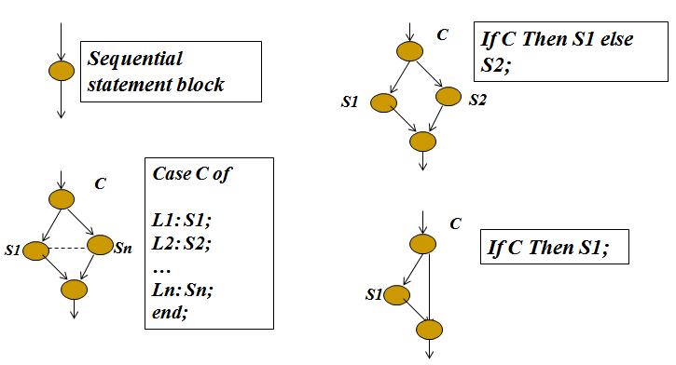
Control Flow Testing

Slide 49
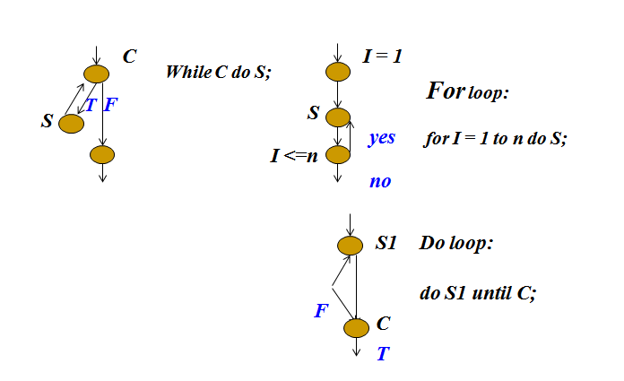
Control Flow Testing

Slide 50
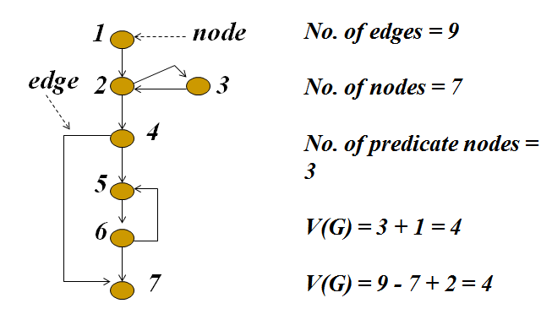
Control Flow Testing

Slide 51
Data Flow Testing
Data Flow testing is to detect improper use of data values due to coding errors.
Variables that contain data values have a defined life cycle. They are created, they are used and they are killed (destroyed).

Slide 52
Data Flow Testing
Possibilities for the first occurrence of a variable through a program path.
    ~d The variable does not exist, then it is defined (d).
    ~u The variable doesn't exist, then it is used (u).
    ~k The variable doesn't exist, then it is killed or destroyed (k).

Slide 53
Data Flow Testing
Examine time sequence pair of define (d), used (u) and killed (k):
    dd Not invalid but suspicious. Probably a programming error.
    du Perfectly correct. The normal case.
    dk Not invalid but probably a programming error.
    ud acceptable

Slide 54
Data Flow Testing
Examine time sequence pair of define (d), used (u) and killed (k):
    uu acceptable
    uk acceptable
    kd acceptable.
    ku a serious defect
    kk probably a programming error.

Slide 55
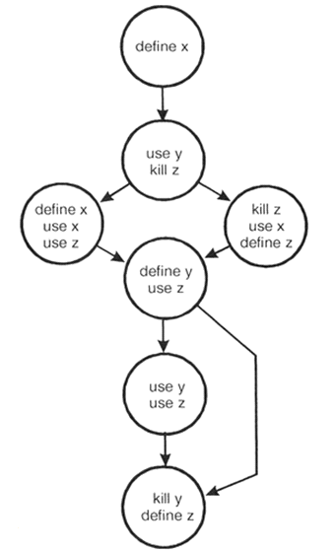
Data Flow Testing

Slide 56
Coverage Testing
It measures the adequacy of the test cases.
Measure the completeness of the set of test cases.
Method Coverage: it is a measure of the percentage of methods that have been called by your test cases.
Statement Coverage: It is the measure of the percentage of program statements that are run when your tests are executed.

Slide 57
Coverage Testing
Decision or Branch Coverage: It is a measure of how many of the boolean expressions of the program have been evaluated as both true and false in the testing.
Condition Coverage: It reports the true or false outcome of each boolean sub-expression of a compound predicate.

Slide 58
Test Design Techniques
Black box Testing Techniques
    Equivalence Partitioning
    Boundary value analysis
    Decision table
    Error Guessing
    Cause-effect graphing.
White box Testing Techniques
    Statement Coverage
    Decision Coverage
    Condition Coverage

Slide 59
Black box Testing Techniques
Equivalence Partitioning
    In this method input domain data is divided into different equivalence data classes according to specification.
    Using equivalence partitioning method test cases can be divided into sets of input data called as equivalence classes with some valid and invalid inputs.

Slide 60
Black box Testing Techniques
Boundary value analysis.
    Boundary value analysis is a next part of Equivalence partitioning for designing test cases where test cases are selected at the edges of the equivalence classes.
    Test cases with test data exactly as the input boundaries of input domain.
    Test data with values just below the extreme edges of input domains
    Test data with values just above the extreme edges of input domain

Slide 61
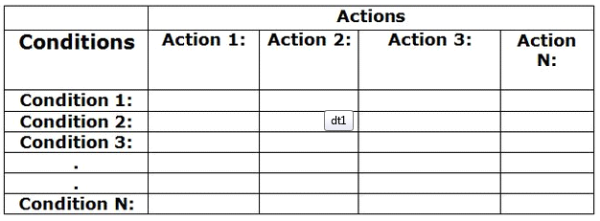
Black box Testing Techniques
Decision table.
    Decision tables are used to record complex business rules or scenario and break down into simpler tabular format called decision tables.

Slide 62
Black box Testing Techniques
Error Guessing
    This technique is used to perform adhoc testing.
    Adhoc testing is an informal testing type with an aim to break the system. This testing is usually an unplanned activity .
    Error guessing can be done by the people having enough experience on the system to “guess” the most likely source of errors.
    This testing requires no documentation/ planning/process to be followed.

Slide 63
Black box Testing Techniques
Cause-Effect Graphing
    Directed graph that maps a set of causes to a set of effects.
    Causes may be thought of as the input to the program, and the effects may be thought of as the output.
    Nodes representing the causes on the left side and the nodes representing the effects on the right side. There may be intermediate nodes inbetween that combine inputs using logical operators such as AND and OR.

Slide 64
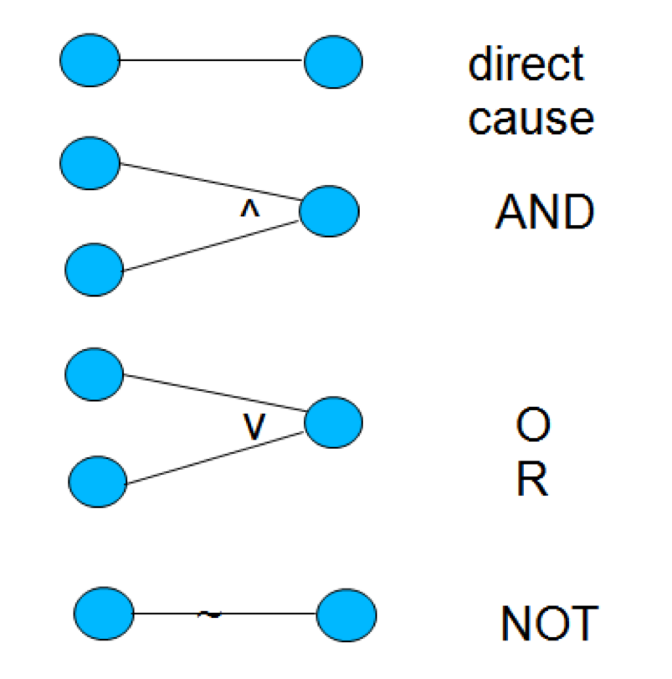
Black box Testing Techniques
Cause-Effect Graphing

Slide 65
White box Testing Technique
Statement Coverage
  Also known as line or segment coverage.
  It covers only the true conditions.
  Identify statements executed and where the code is not executed because of blockage.
  Each and every line of code needs to be checked and executed.

Slide 66
White box Testing Technique
Decision Coverage
  Also known as branch coverage or all-edges coverage.
  Covers both the true and false conditions.
  It measure which decision outcomes have been or not been tested.
  A decision is an If statement, a loop control statement( Do-While or Repeat-Until) or a case statement.

Slide 67
White box Testing Technique
Condition Coverage
    Condition coverage reports the true or false outcome of each condition.
    It measures the conditions independently of each other.
    It requires the coverage of all conditions that can affect or determine the decision outcome.

